Slide 1

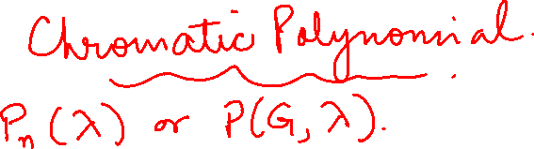
GRAPH THEORY AND ITS APPLICATIONS
Dr. Arti Arya
Department of Computer Science & Engineering

Slide 2
GRAPH THEORY AND ITS APPLICATIONS
Graph Coloring
Dr. Arti Arya
Department of Computer Science & Engineering

Slide 3
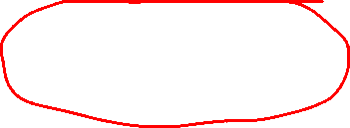
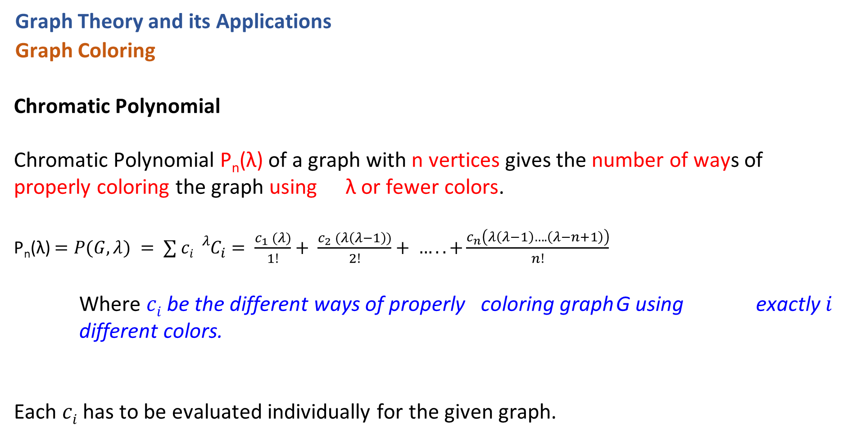
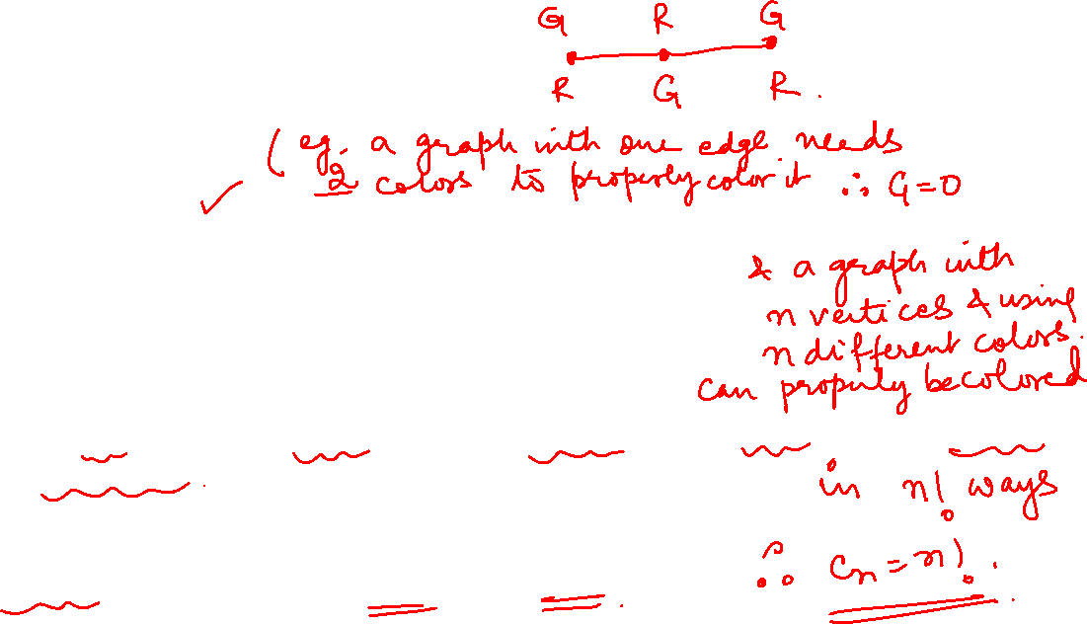
Graph Theory and its Applications
Graph Coloring
Chromatic Polynomial
Chromatic Polynomial P_{n}(λ) of a graph with n vertices gives the number of ways of properly coloring the graph using λ or fewer colors.
P_{n}(λ) $=P(G, λ) = ∑ ci {}_{}^{λ}{C_{i}}= \frac{c_{1} (λ)}{1!}+ \frac{c_{2} (λ\left(λ−1\right))}{2!}+ ….. +\frac{c_{n}\left(λ\left(λ−1\right)….\left(λ−n+1\right)\right)}{n!}$
Where $ci$be the different ways of properly coloring graph G using exactly $i$ different colors.
Each $ci$ has to be evaluated individually for the given graph.

Slide 4
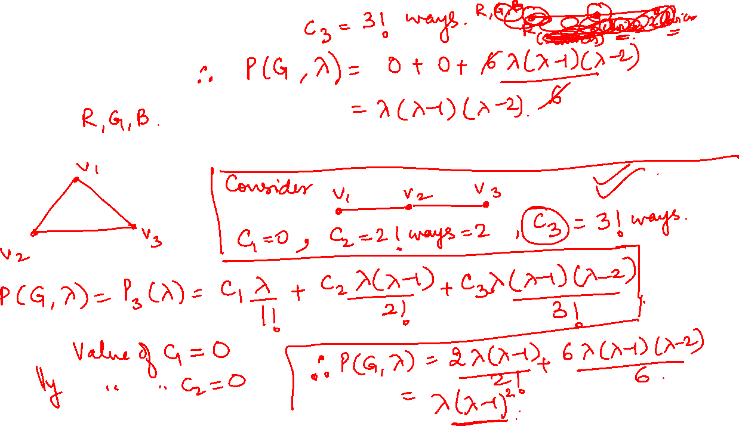
Graph Theory and its Applications
Graph Coloring
Chromatic Polynomial
1.Find the chromatic polynomial of a connected graph with 3 vertices.

Slide 5
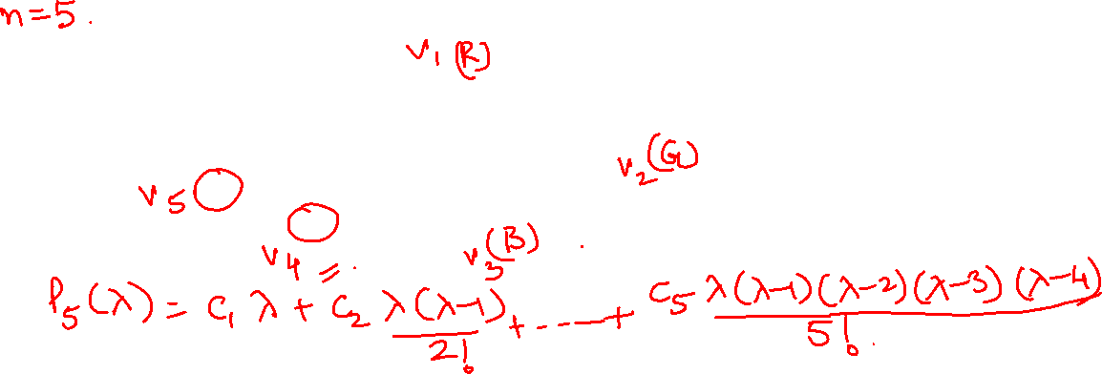
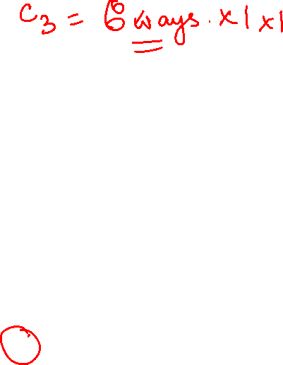
Graph Theory and its Applications Graph Coloring
Chromatic Polynomial
1. Find the chromatic polynomial of the given graph.

Slide 6
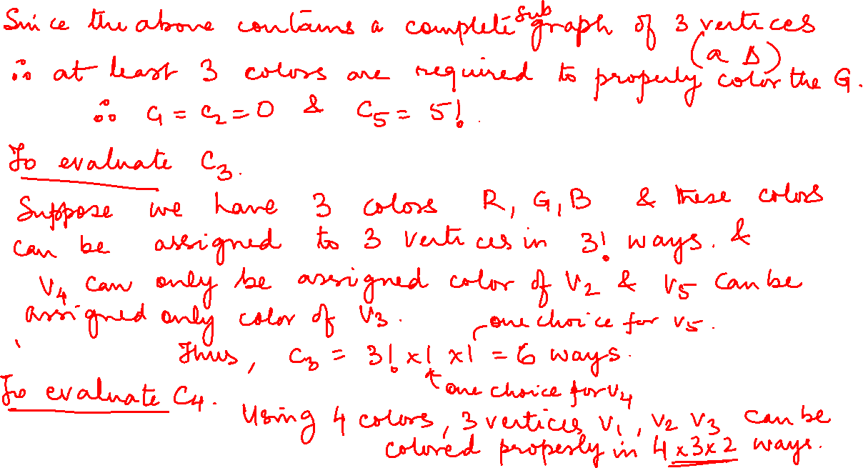

Slide 7
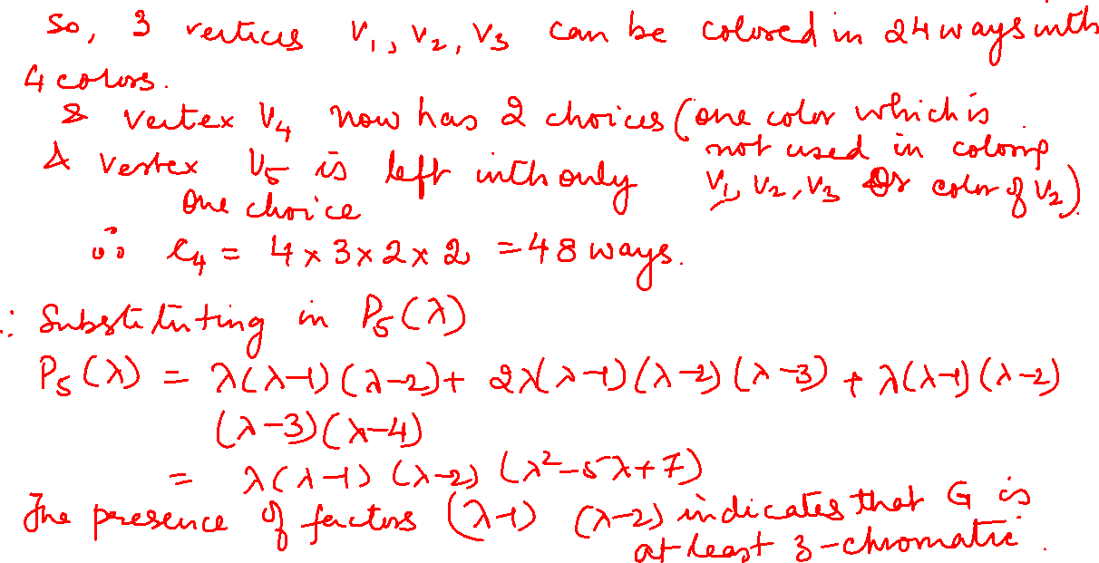

Slide 8

Graph Theory and its Applications Graph Coloring
Product Rule
If G is made up of n connected components G1, G2, …Gn then P(G, λ) is given by the following rule
P(G, λ)=P(G1, λ)*P(G2, λ)*….P(Gn, λ)

Slide 9
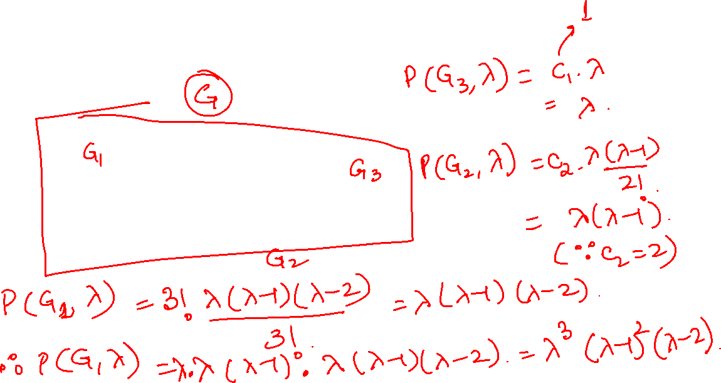
Graph Theory and its Applications Graph Coloring
Find the chromatic polynomial for the given graph

Slide 10
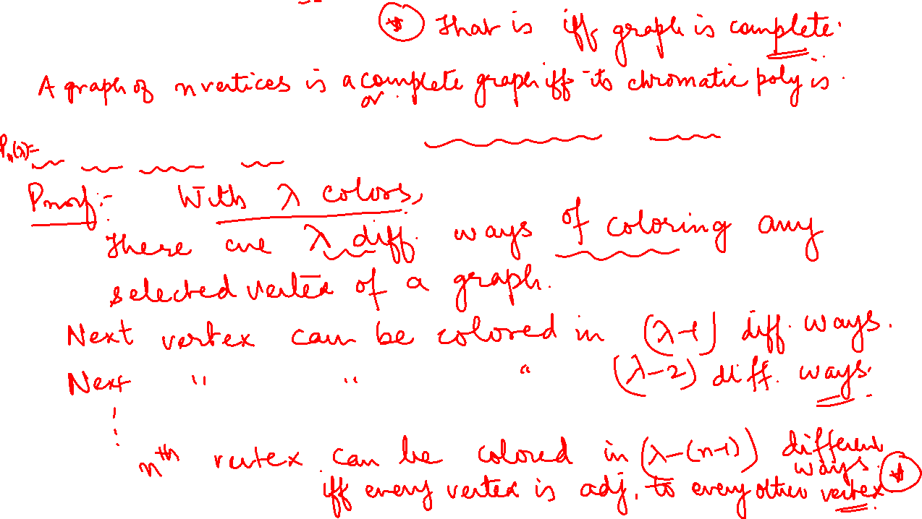
Graph Theory and its Applications
Graph Coloring
Prove that the chromatic polynomial of a complete graph of n vertices K_{n} is
λ(λ-1)(λ-2)…(λ-n+1) if λ>=n

Slide 11
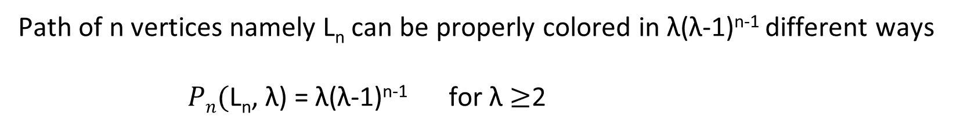
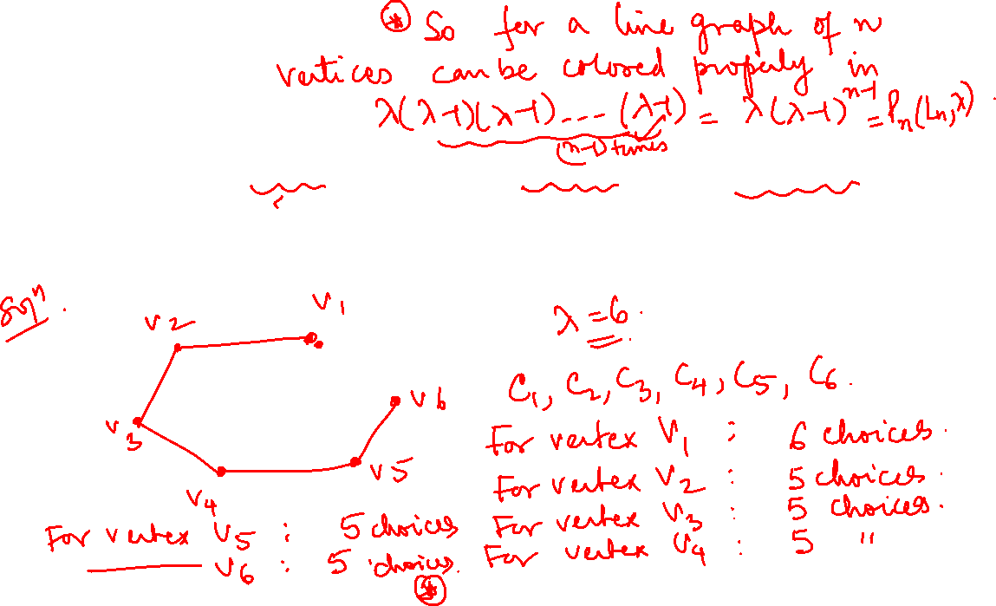
Graph Theory and its Applications Graph Coloring
Path of n vertices namely L_{n} can be properly colored in λ(λ-1)^{n-1} different ways
$Pn($L_{n}, λ) = λ(λ-1)^{n-1} for λ $≥$2

Slide 12
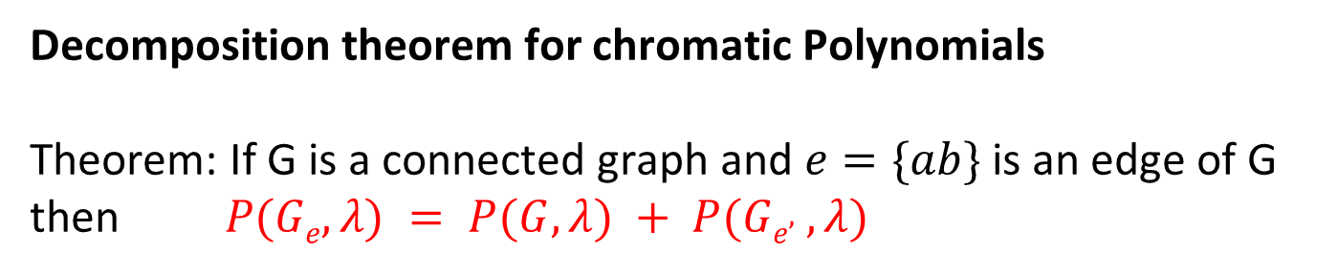
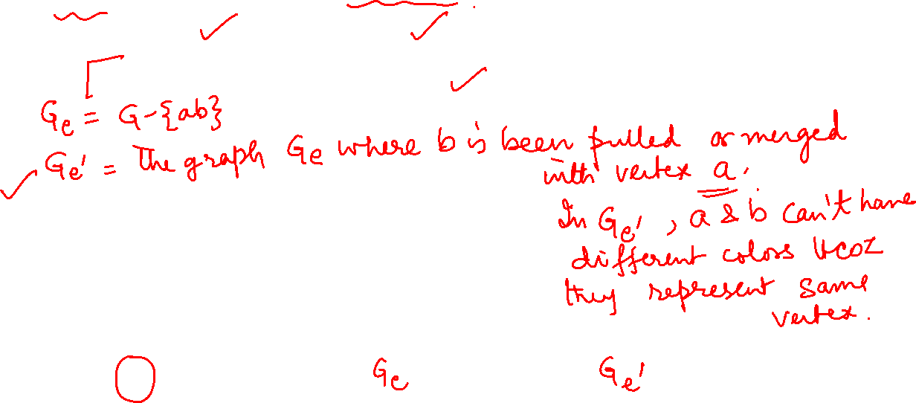
Graph Theory and its Applications Graph Coloring
Decomposition theorem for chromatic Polynomials
Theorem: If G is a connected graph and $e=\{ab\}$is an edge of G then $P(Ge, λ) = P(G, λ) + P(Ge’ , λ)$
d
b
d
b
d
a
c
a
c
a=b
c
G
Ge
Ge’

Slide 13
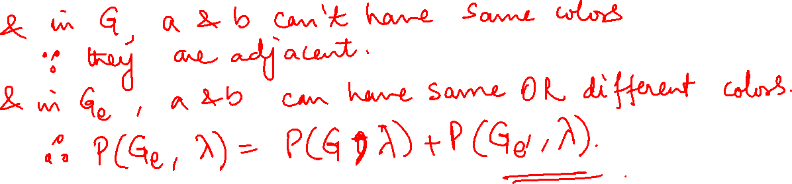
Graph Theory and its Applications Graph Coloring
d
b
d
b
d
a
c
a
c
a=b
c
G
Ge
Ge’

Slide 14
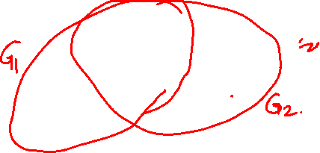
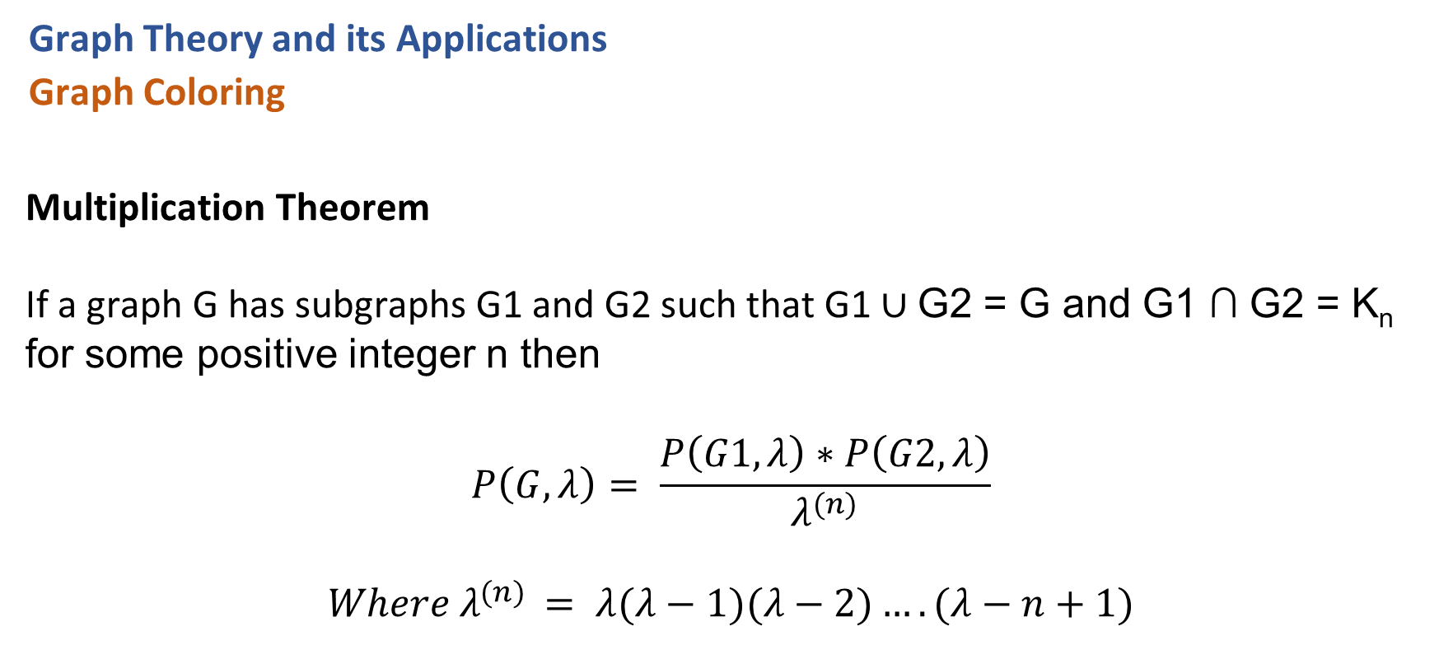
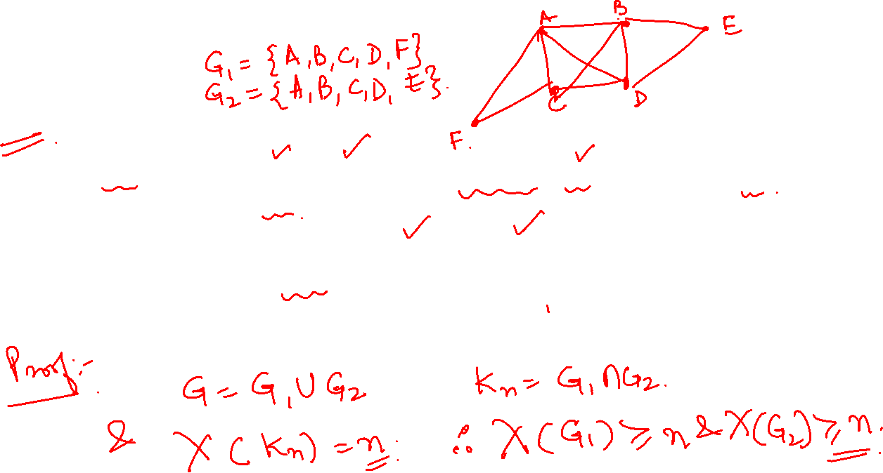
Graph Theory and its Applications
Graph Coloring
Multiplication Theorem
If a graph G has subgraphs G1 and G2 such that G1 ∪ G2 = G and G1 ∩ G2 = K_{n} for some positive integer n then
$$P\left(G, λ\right)= \frac{P\left(G1, λ\right)∗P\left(G2, λ\right)}{λ^{(n)}}$$
$$Where λ^{(n)} = λ(λ−1)(λ−2)….(λ−n+1)$$

Slide 15
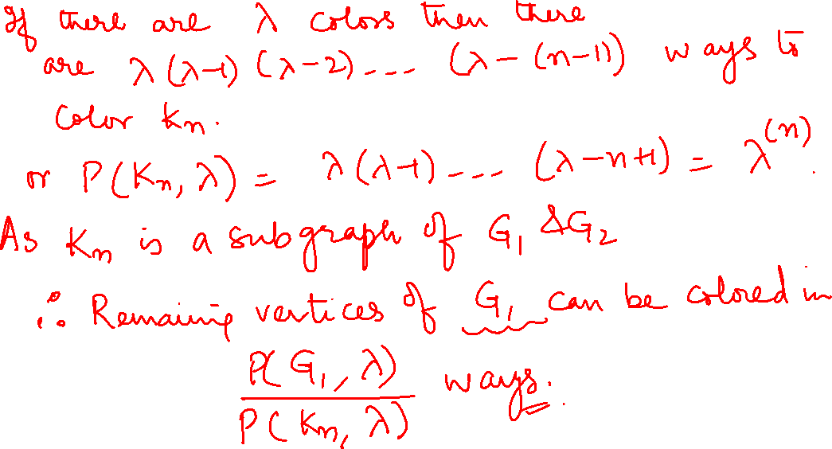

Slide 16
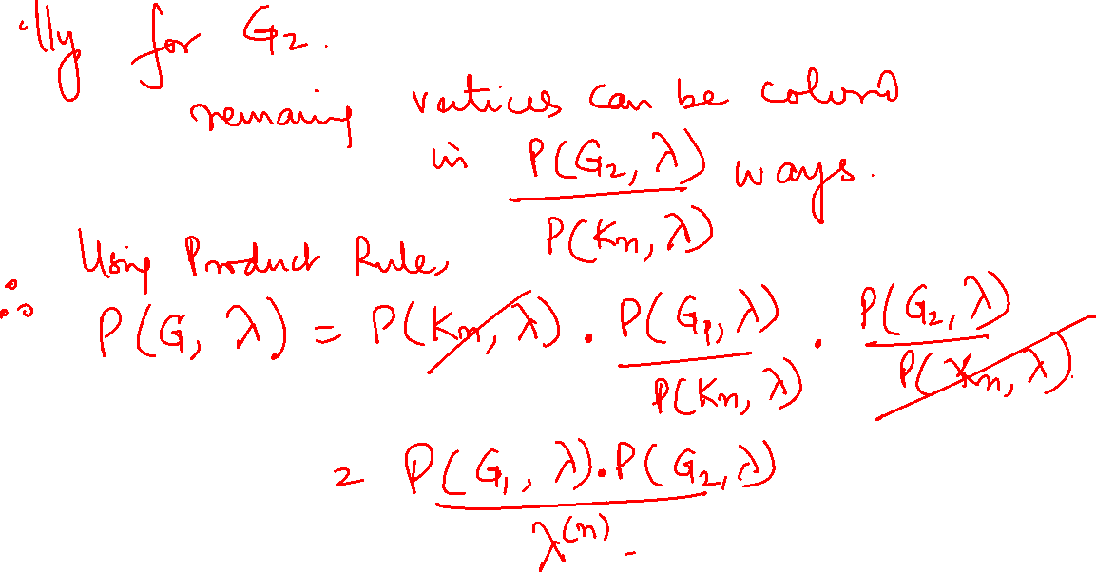

Slide 17
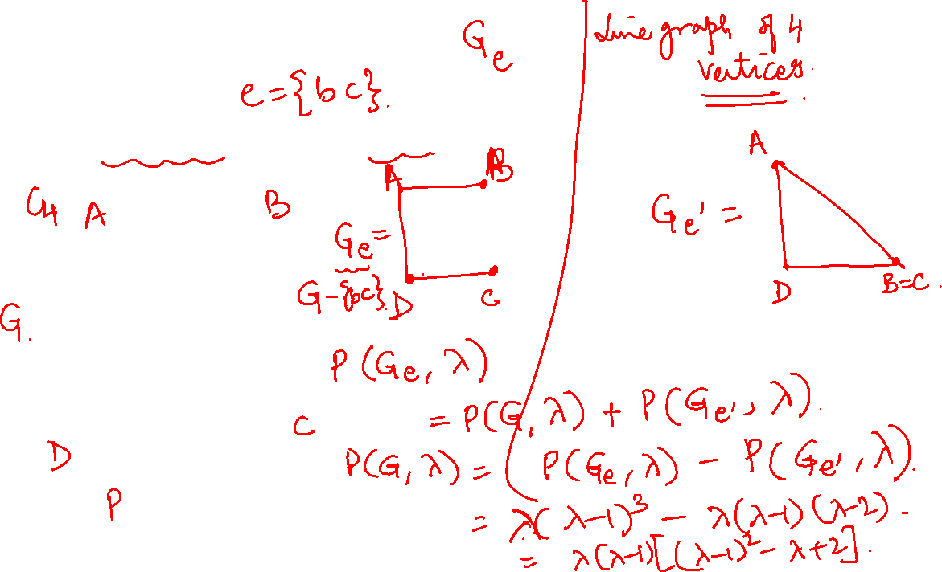
Graph Theory and its Applications
Graph Coloring
Find the chromatic polynomial for the graph G

Slide 18
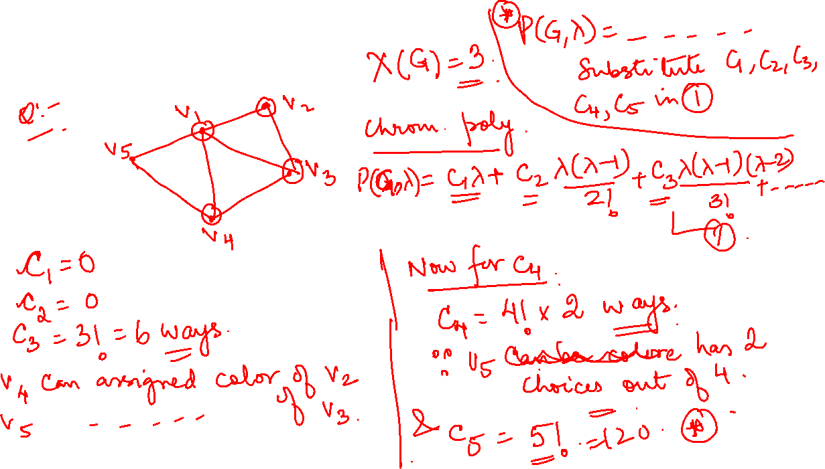
Some more examples

Slide 19
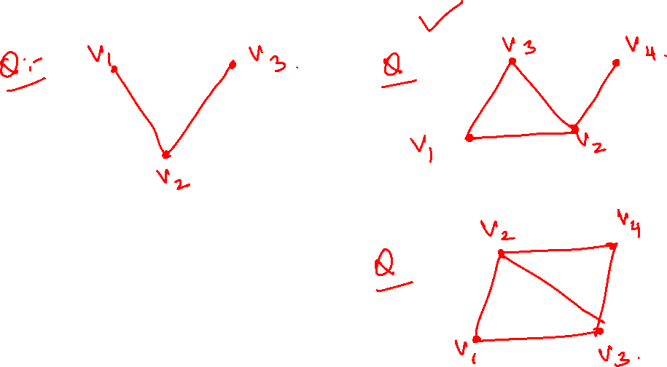
Some more examples

Slide 20
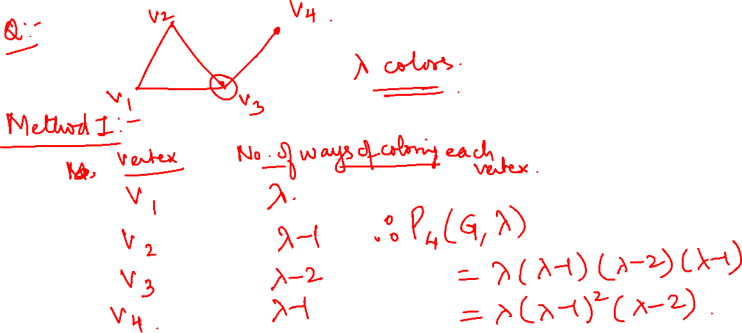
Some more examples

Slide 21
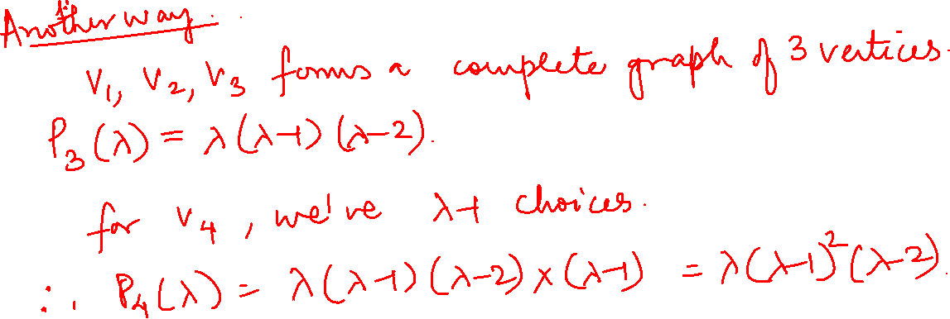
Some more examples

Slide 22
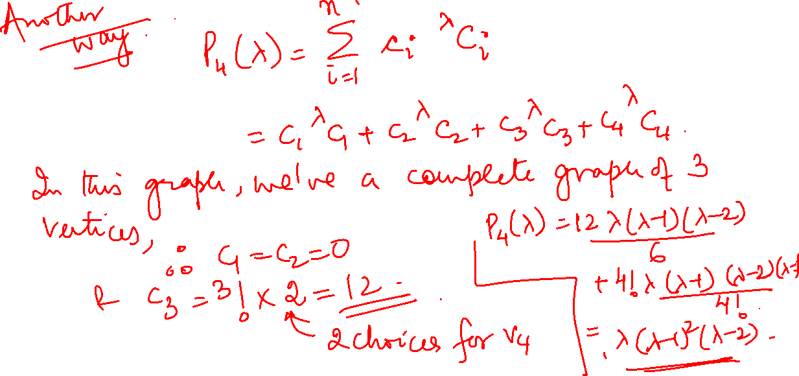
Some more examples

Slide 23
Graph Theory and its Applications
Graph Coloring (Practice)
Find the chromatic polynomial for the graph G

Slide 24
Graph Theory and its Applications
Graph Coloring
Chromatic Polynomial
1. Find the chromatic polynomial of the given graph.

Slide 25
Find the chromatic polynomials for the graphs( Practice)

Slide 26
Graph Theory and its Applications
Graph Coloring
Find the chromatic polynomial for the graph G

Slide 27
THANK YOU
Dr. Arti Arya
Department of Computer Science &Engineering
artiarya@pes.edu

